Slide 1
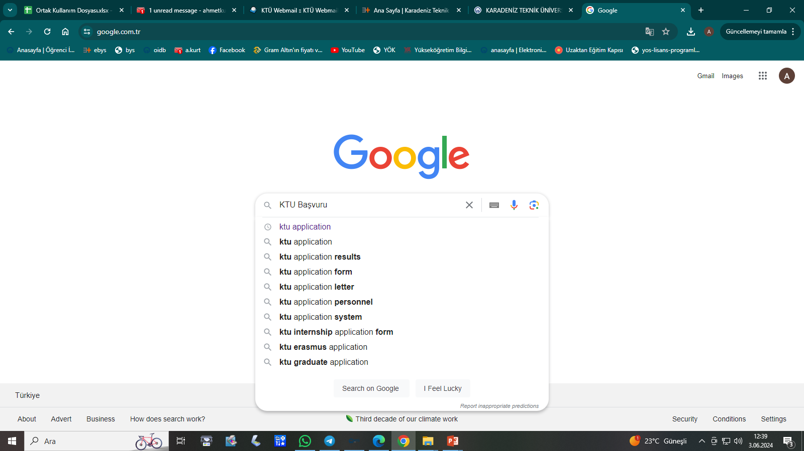
Type Karadeniz Technical University application in the search box and start the search.

Slide 2
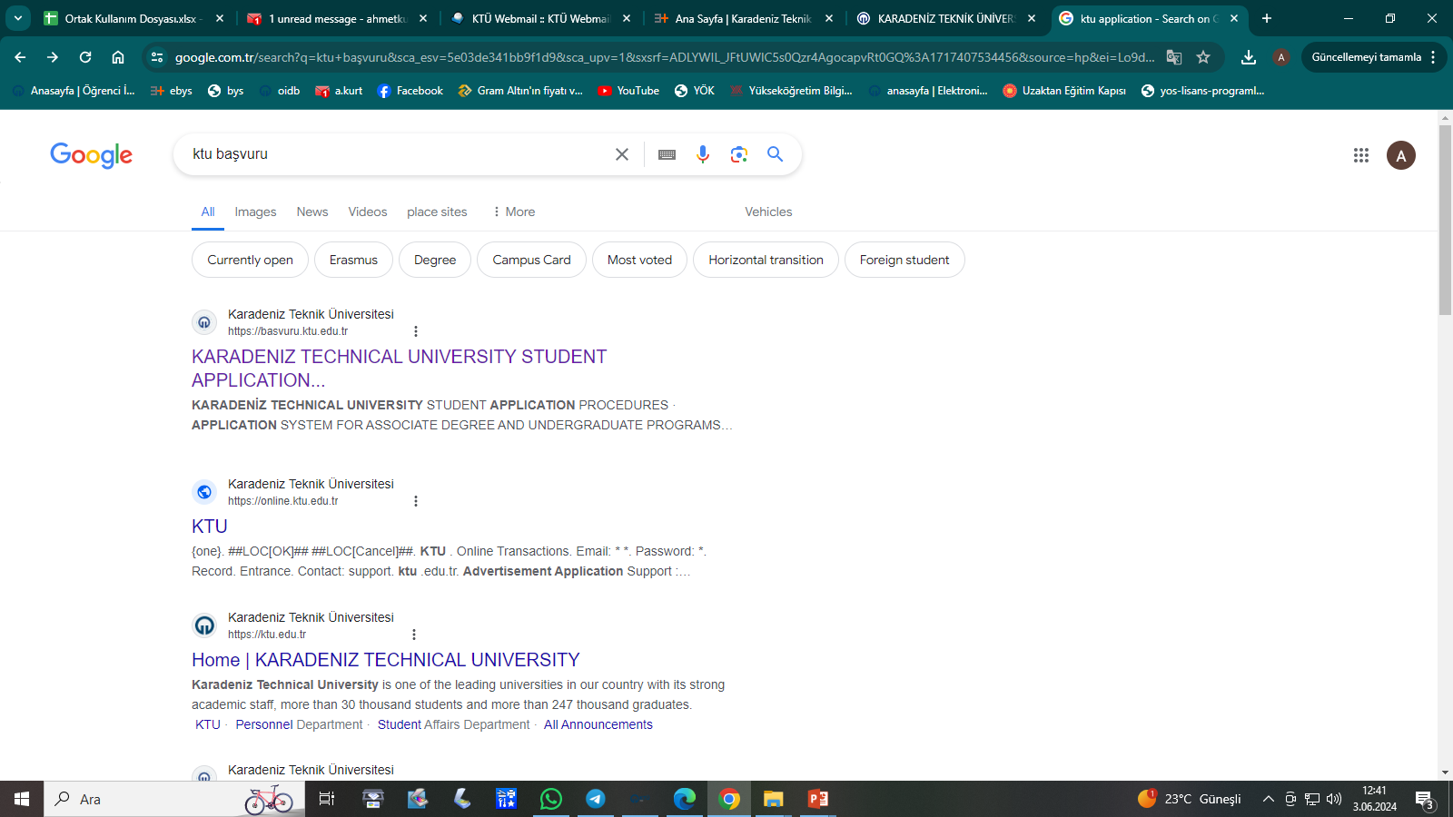
Click on the title

Slide 3
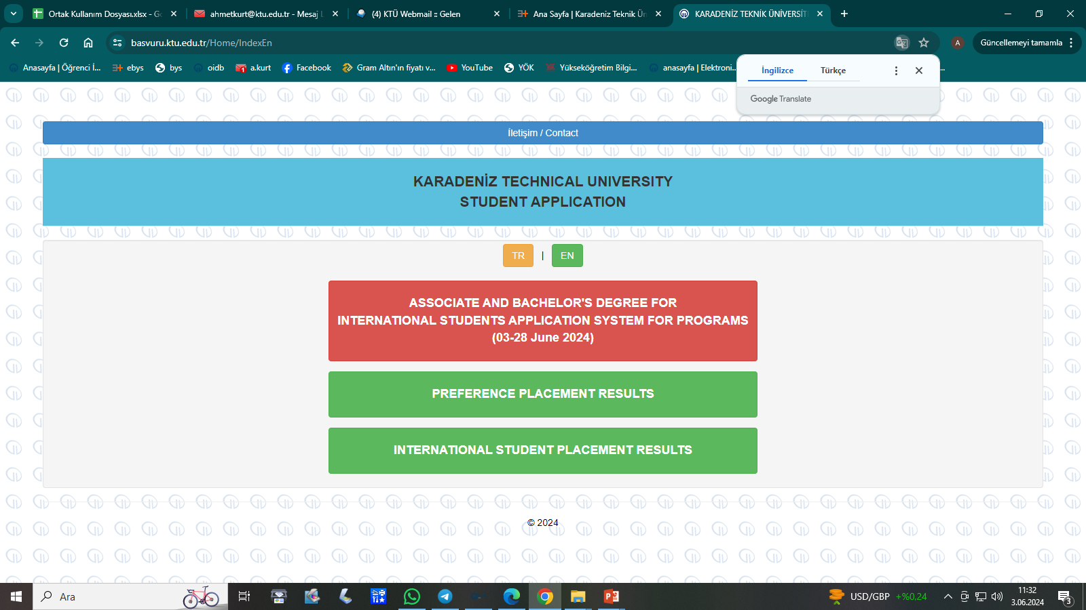
You can change your language preference here.
Click

Slide 4
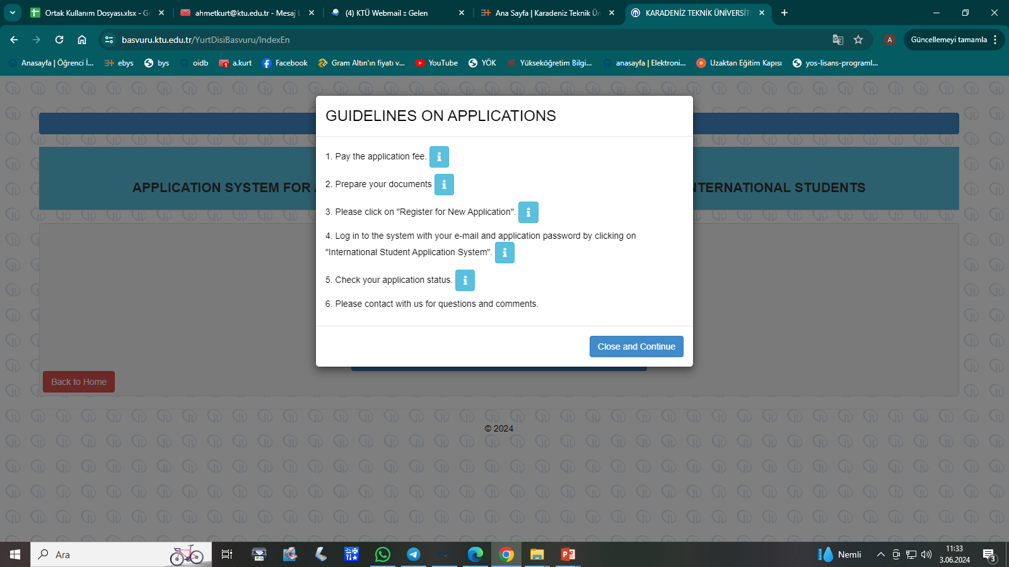
Click

Slide 5
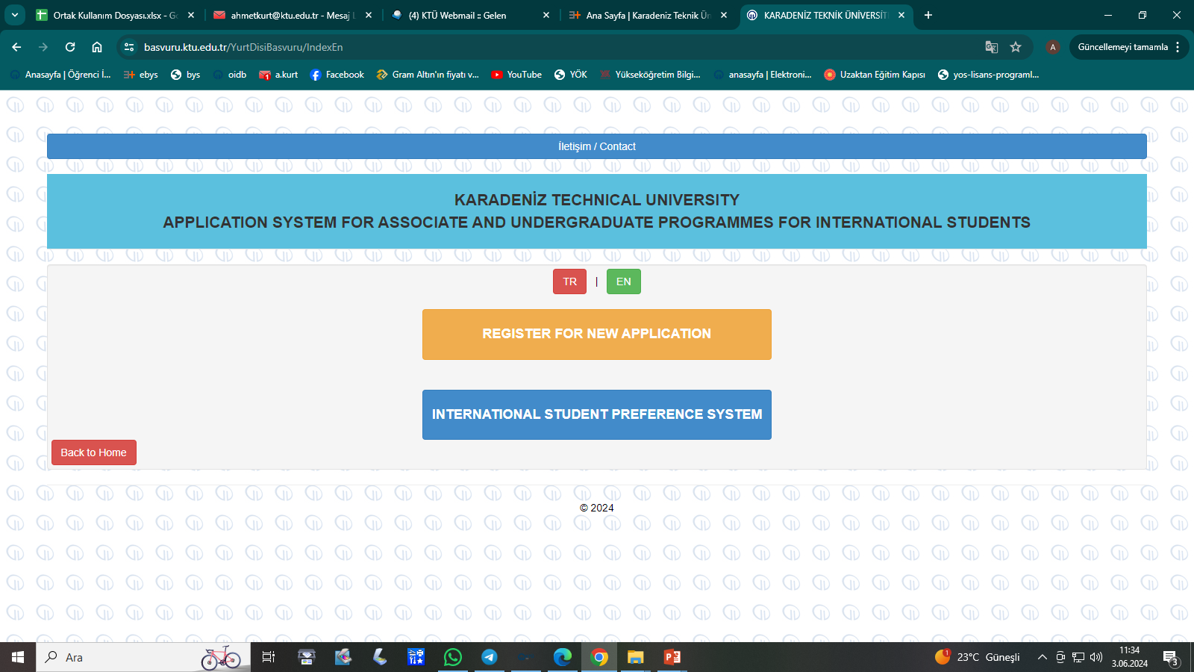
Click here to get your application number, application password and application fee payment link.
You can change your language preference here

Slide 6
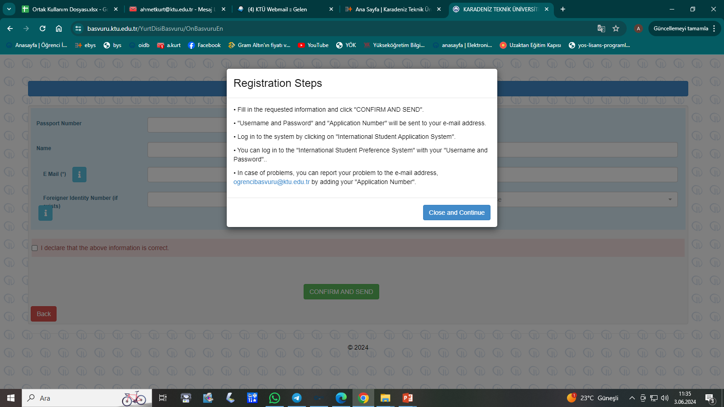
Click

Slide 7
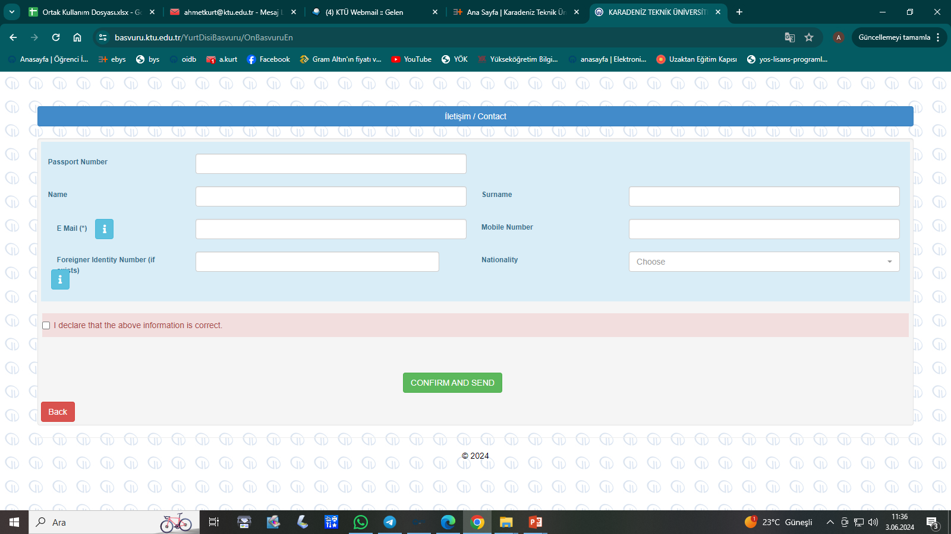
Your e-mail address that you actively use.
Enter without a leading zero.
Foreign national identification number issued by the Authorities of the Republic of Türkiye. (If any)
Those with dual nationality must choose their nationality acquired at birth.
!
Check the box.
To the e-mail address you specified when you clicked the Confirm and Send button:
-Your Application number
-Your Application Password
-A link will be sent to you to pay your Application Fee.

Slide 8
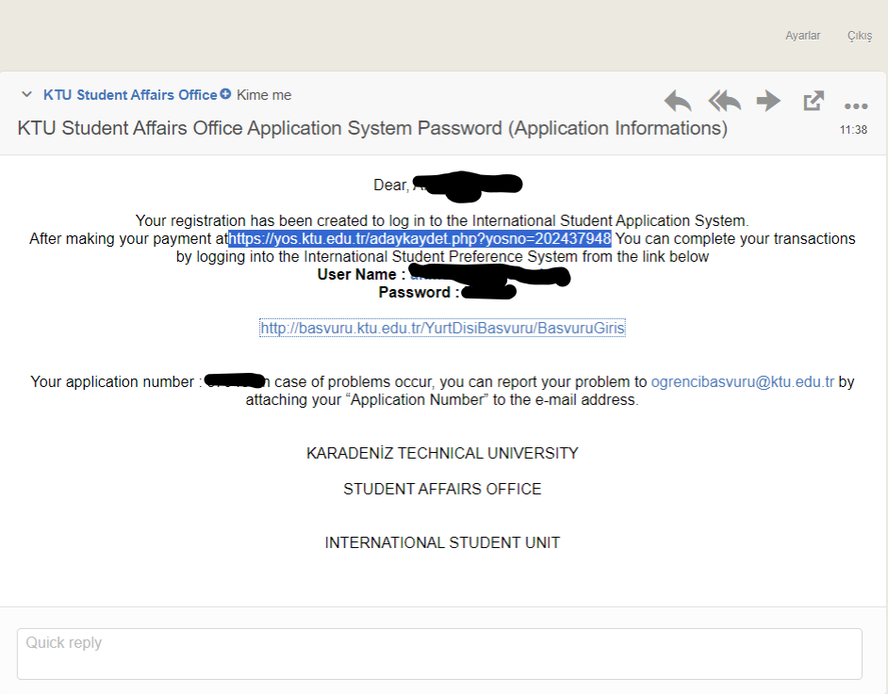
Make your payment by clicking the link.
After making your payment, you can proceed to the preference system by clicking the link.

Slide 9
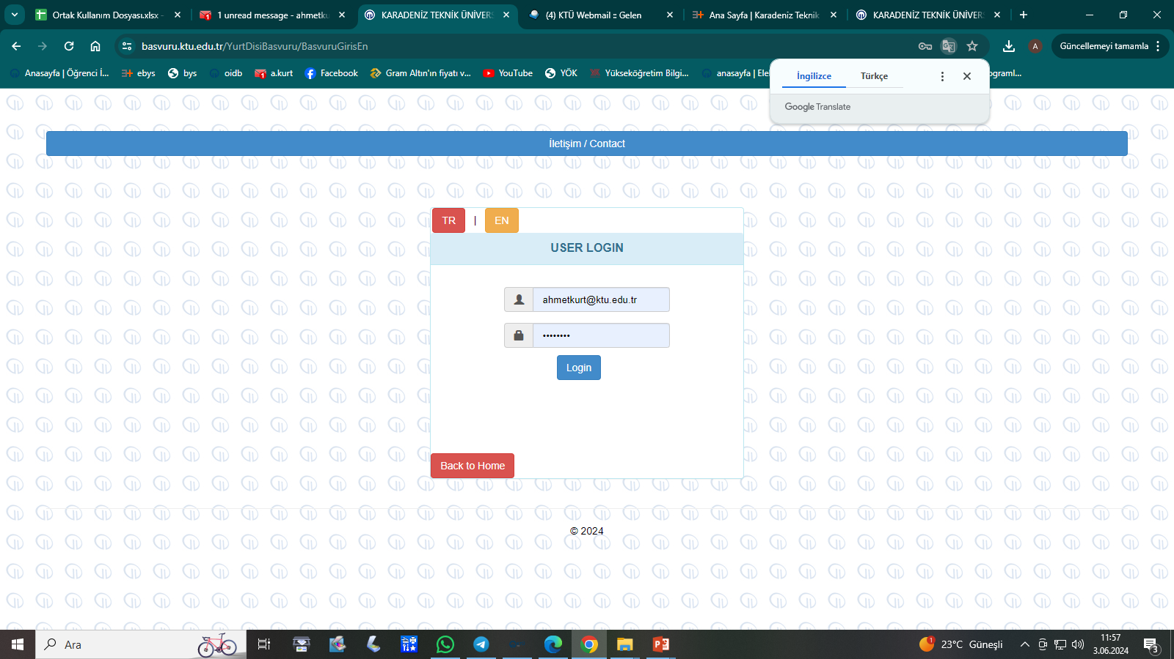
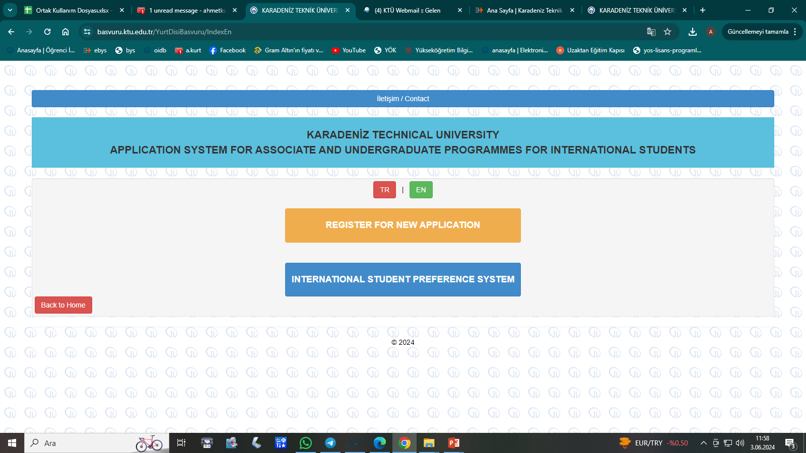
! -You must make your payment by clicking on the application fee payment link sent to your e-mail, otherwise you cannot continue your application.
- After completing the payment of your application fee, you will be directed to the page below when you click on the link sent to your e-mail to log in to the International Student Preference System.
Or, when you go back to the beginning and follow slides 1,2,3,4 and view the page below (Slide 5), you will be directed to the same page shown on the left by clicking on the second heading, International Preference System.
You can log in with the password sent to your e-mail.
Click

Slide 10
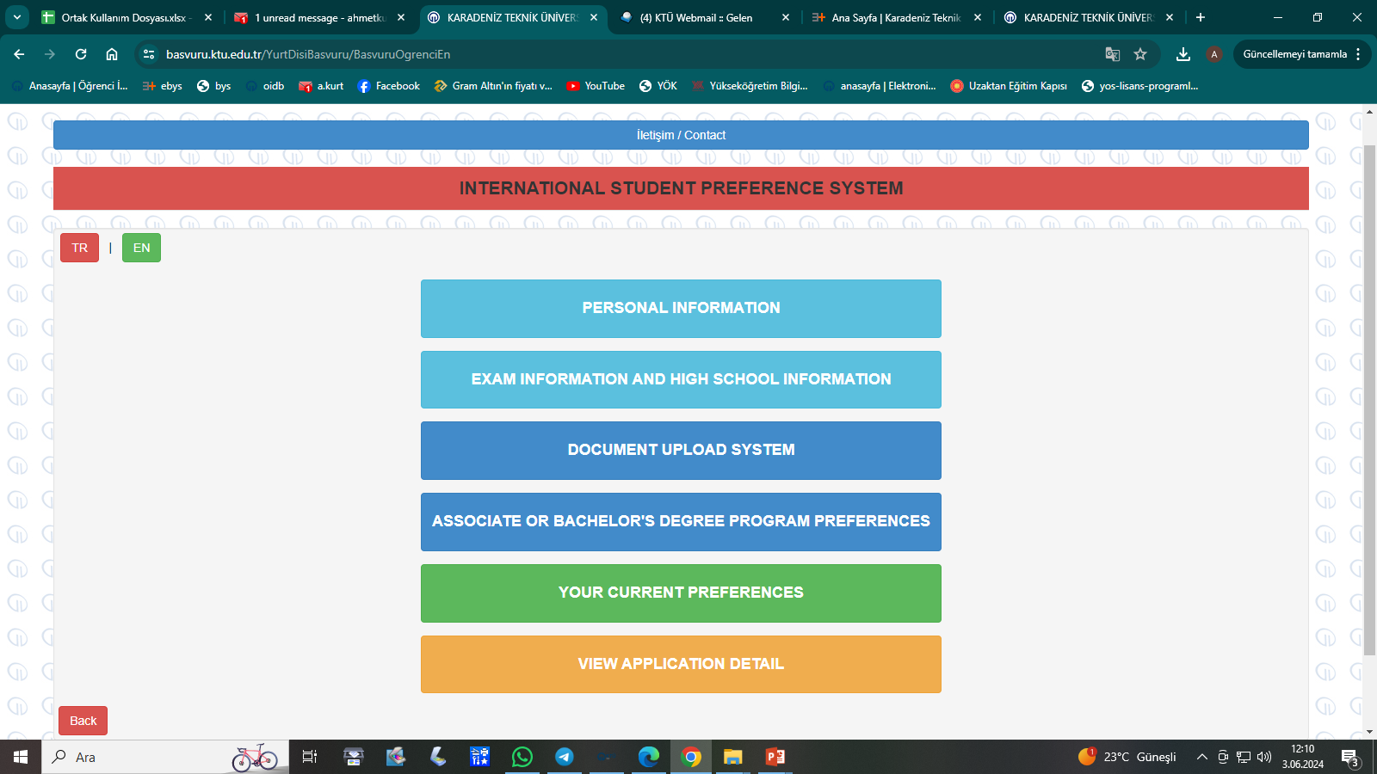
Click
Each time you enter the required information on the page that opens and click on the Save and Continue button, the next subheading will open. This way, you can complete your application without getting any feedback.
You can change your language preference here.

Slide 11
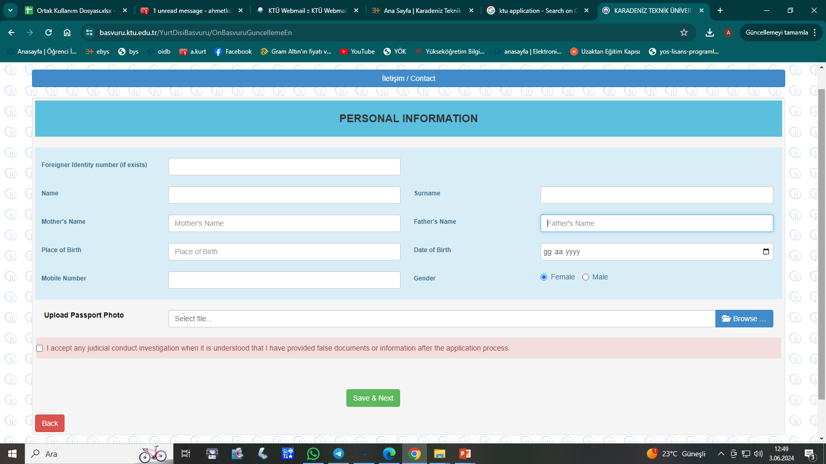
Enter without a leading zero
The photo to be added to this menu must be 50x60 mm in jpg format, taken within the last six months and biometric.
After entering the requested information, continue.

Slide 12
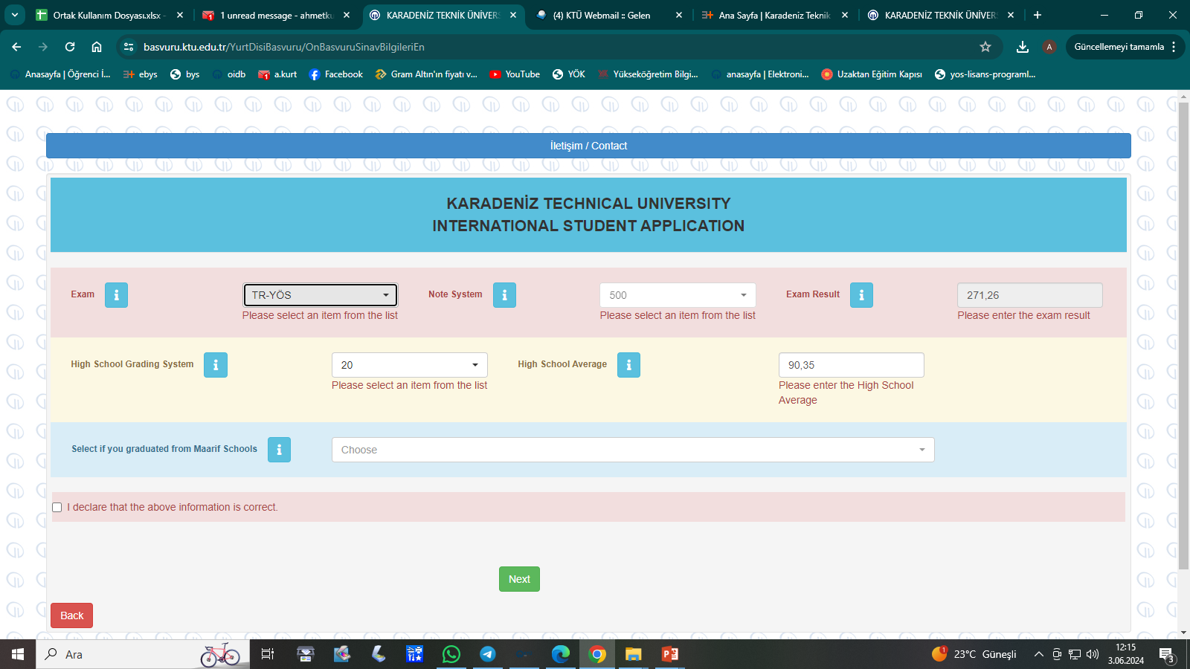
*If any exam or diploma type other than the secondary education score in the exam name list is selected, the exam score system is automatically selected and prospective students cannot intervene in this area.
*Candidates who choose Secondary Education Score as the Exam Name but cannot find their own scoring system in the Exam Score System list will select 100 (one hundred) from the Exam Score System and convert their grade average into a 100 system and enter it into the system as the Exam Result.
After entering the requested information, continue.
Equivalent in the Hundred System $=\frac{Secondary Education Grade Point Average}{Full Score in the Graduating System}x100$

Slide 13
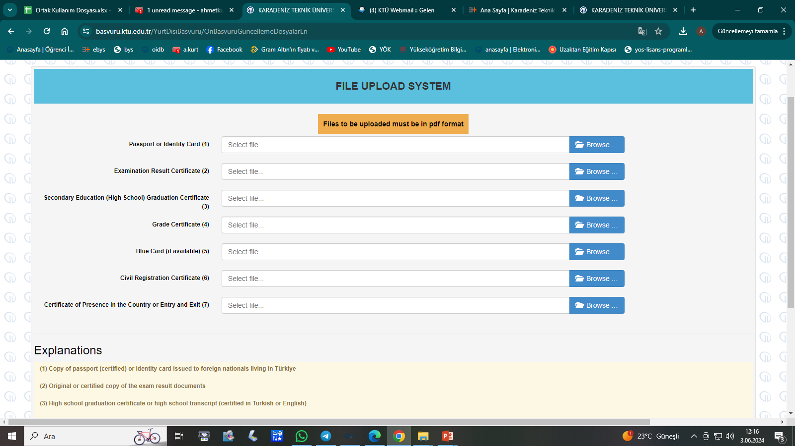
After entering the requested information, continue
Next

Slide 14
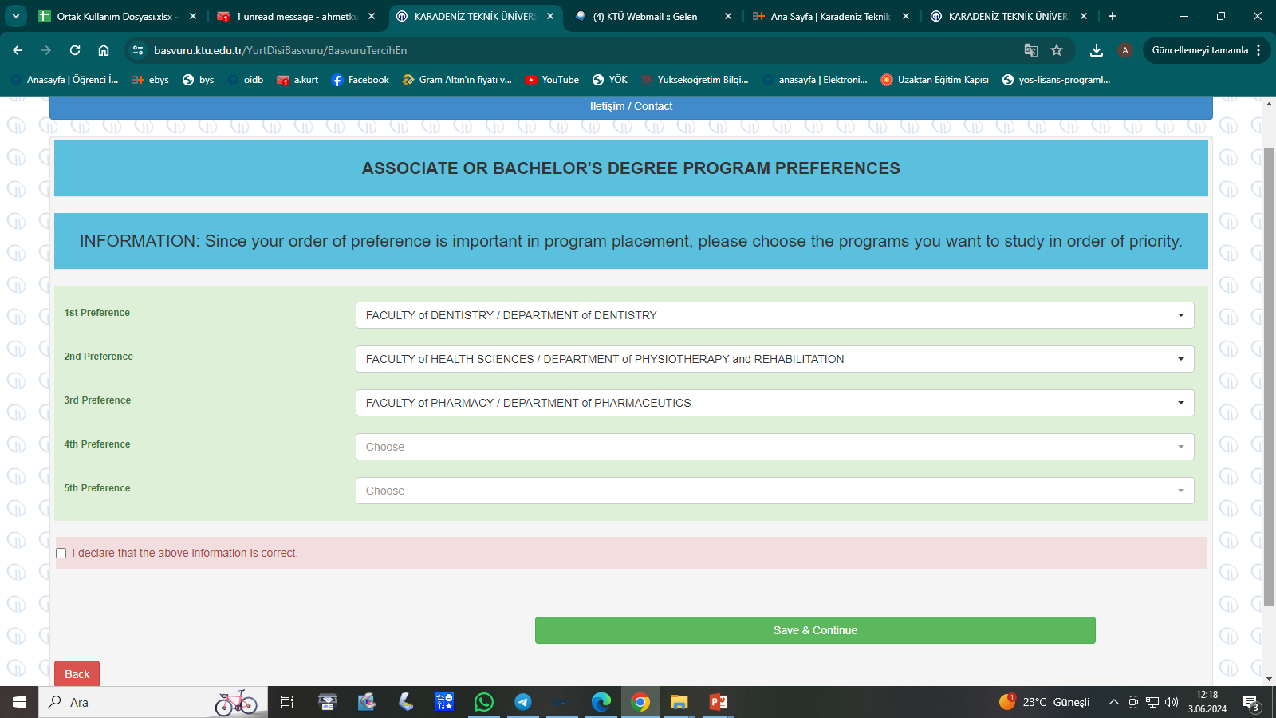
Continue after making your preferences.

Slide 15
Once you have completed your preference process and clicked on the Save and Continue tab, you will have completed your application.
You can Click the View Application tab to view your application.

